Slide 1
Convolutional Neural Networks

Slide 2
A Quick Recap
Machine Learning
Regression vs Classification
Logistic Regression
Deep Learning
Feedfoward Neural Network
Backpropagation

Slide 3
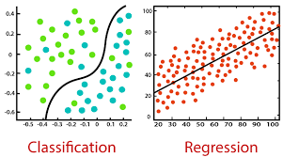
Classification vs Regression

Slide 4
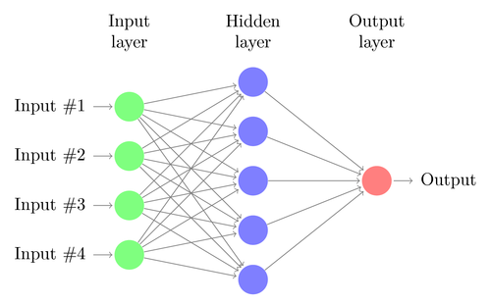
Deep Learning
FeedForward Neural Network

Slide 5

Image Representation

Slide 6
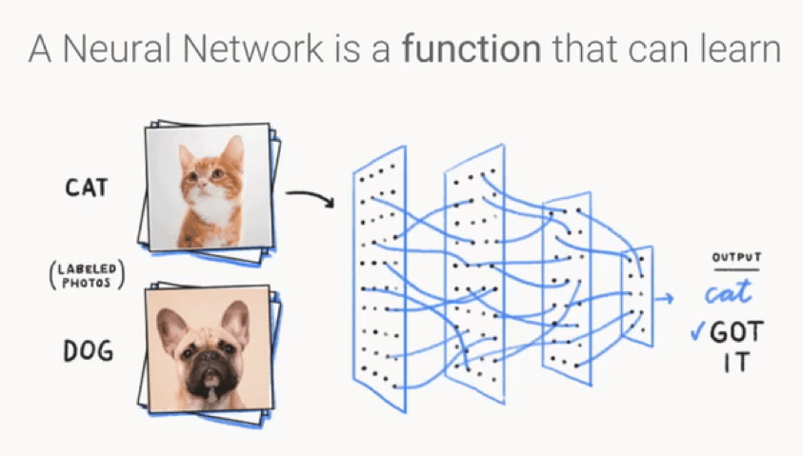
Image Classification
Let us restrict our discussion to the problem of Image Classification.

Slide 7
Problems with Feed Forward Approach
Loss of Spatial Representation
Large number of parameters
Not all features in the image are relevant for the task
Curse of Dimensionality

Slide 8

Convolutions

Slide 9
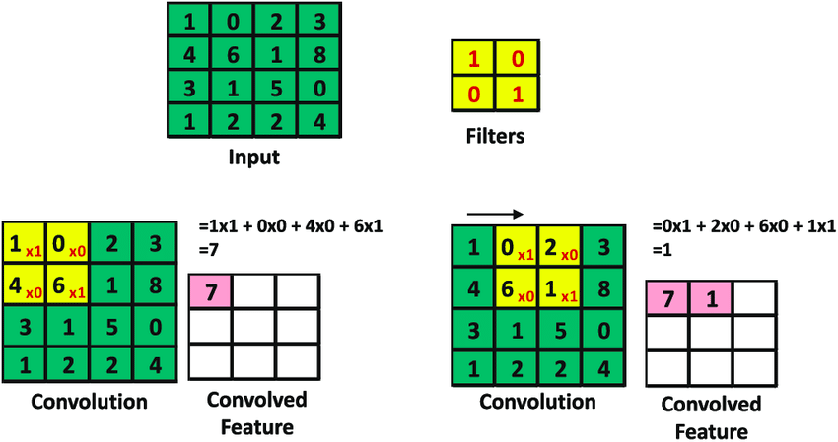
Convolution Filters/Kernels

Slide 10
Why Convolution?
Convolution essentially slides a 2D Filter over the images, and selects the most important features from the image, forming a 2D output matrix, known as a feature map.
For images with large number of pixels, it is beneficial, as the parameters/weights are shared across all the pixels.
Convolution filters concentrate important features, and reduce the dimensions of the input image.

Slide 11
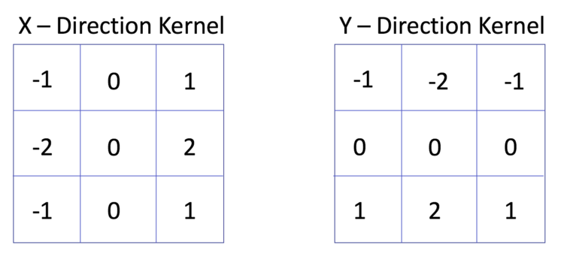
Static vs Dynamic Kernels
Static Kernel: Fixed Weights
Used for calculating specific features in an image.
Example: Sobel Kernels- Detects Edges

Slide 12
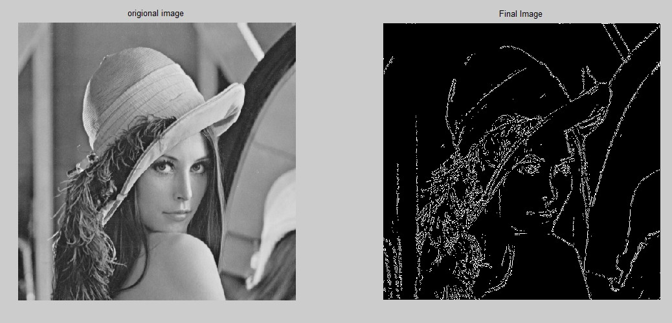
Sobel Kernels: Example of Static Filters

Slide 13
Dynamic Kernels
It has Variable Weights.
It can update weights through backpropagation.

Slide 14
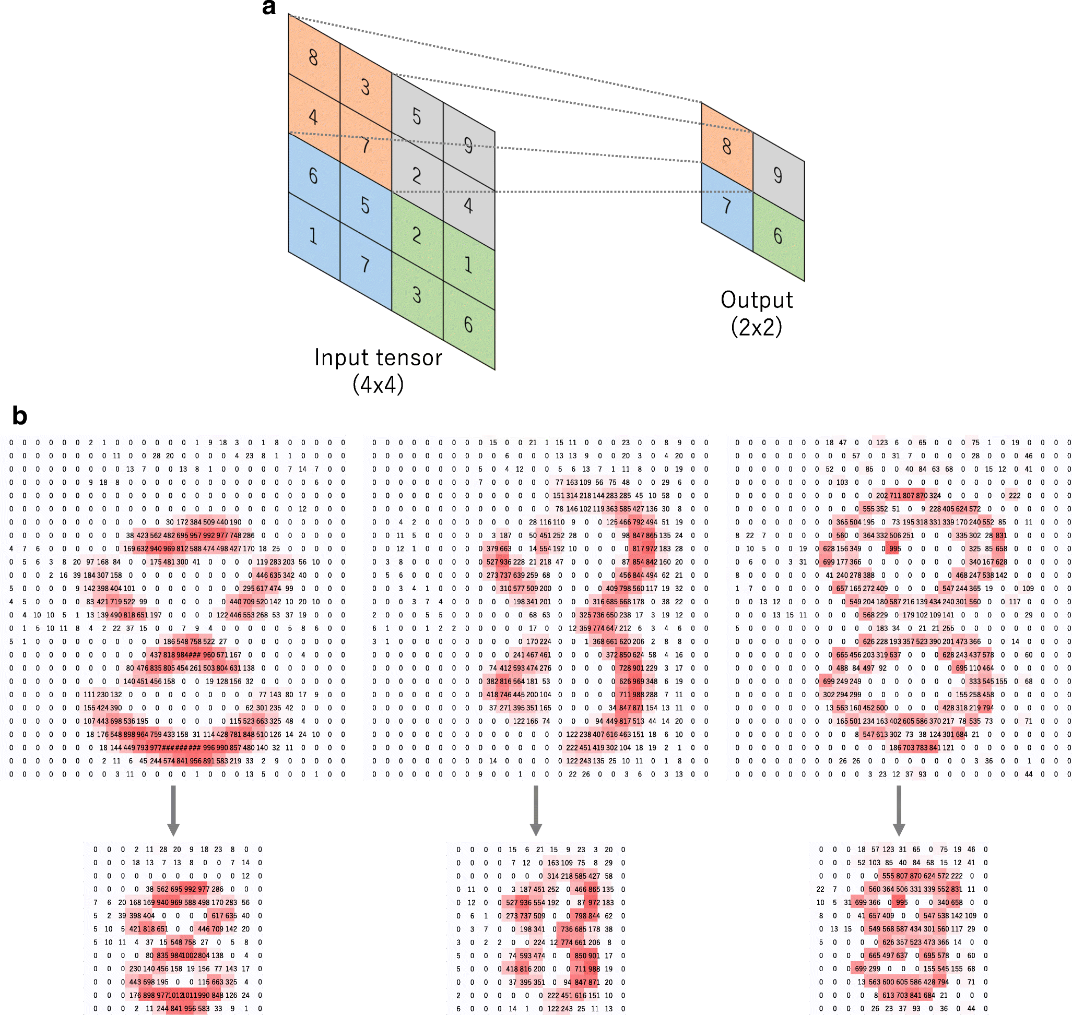
Dynamic Kernels

Slide 15
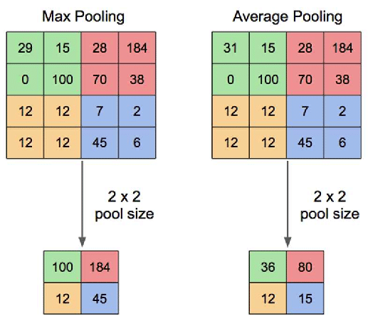
Pooling

Slide 16
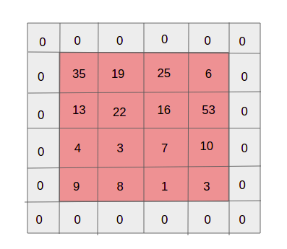
Padding

Slide 17
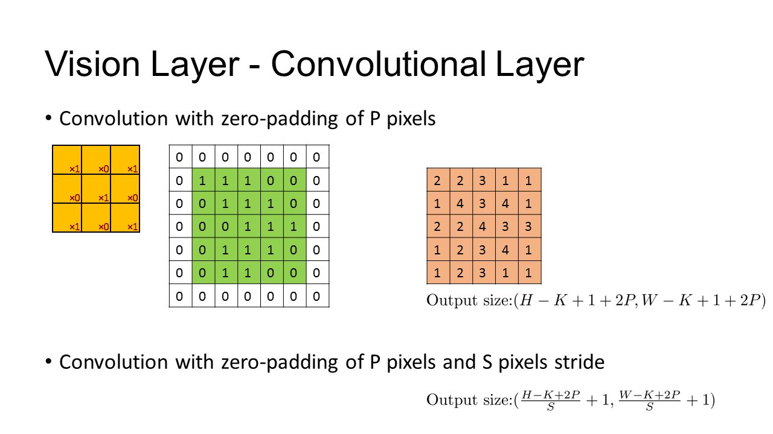
Stride

Slide 18

Building a CNN

Slide 19
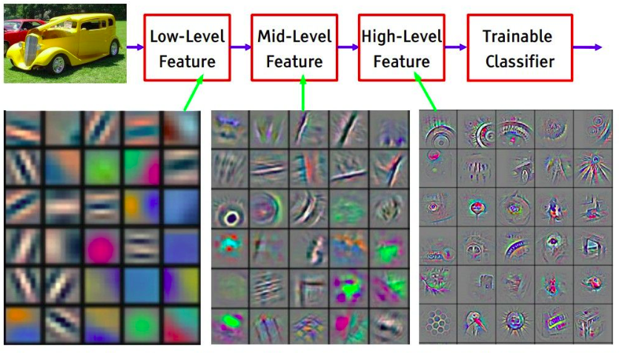
Visualizing Convolutional Neural Networks

Slide 20
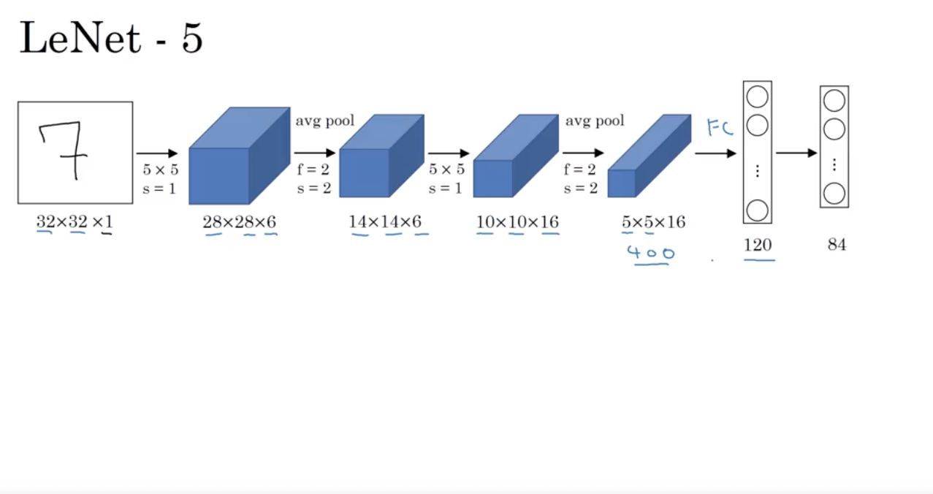
LeNet

Slide 21
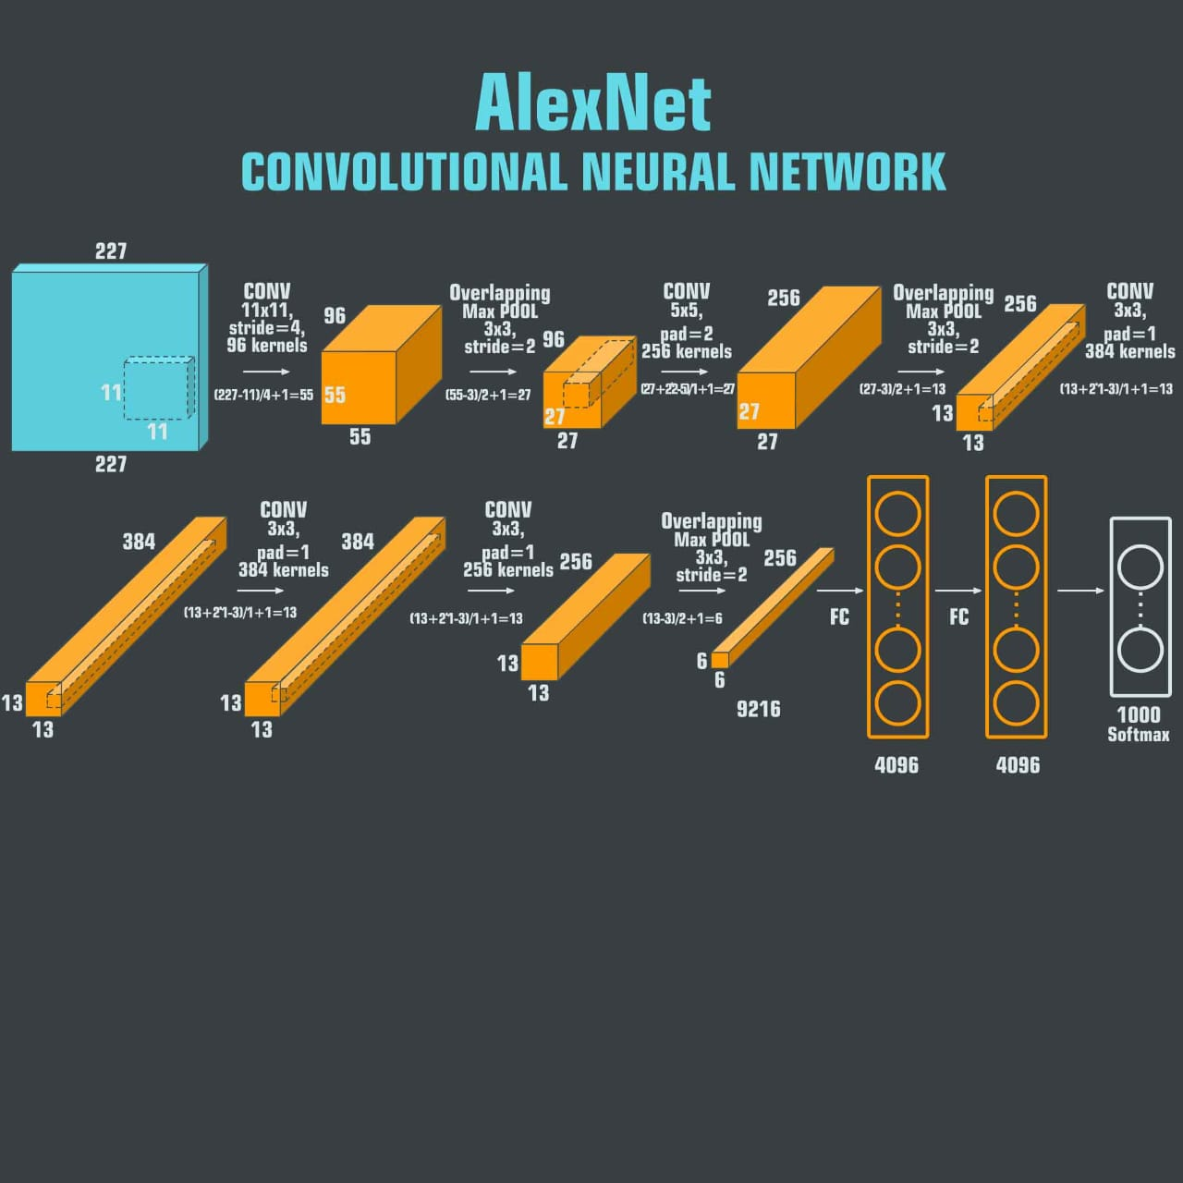

Slide 22
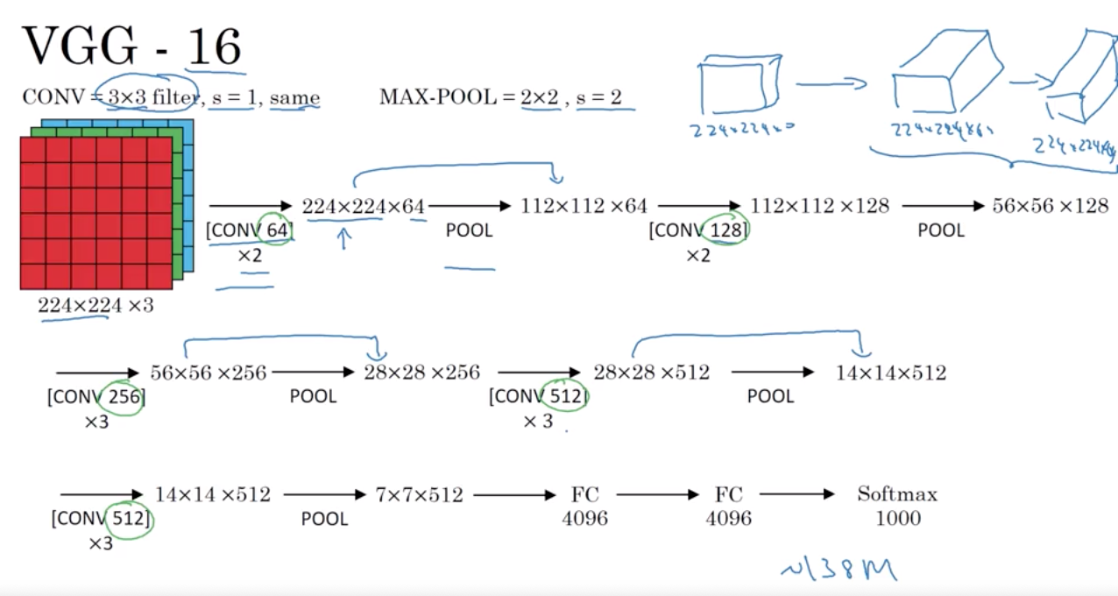
VGG-16

